Slide 1
ASTLI
Advanced
Smart
Traffic Lights
Andrea Leganza
Ghenadie Artic
Alberto Coluzzi

Slide 2

ASTLI
Current Traffic Lights could be improved in some aspects...

Slide 3

ASTLI
Traffic Pollution: stopping cars at traffics lights with fixed time increases pollution.

Slide 4

ASTLI
Traffic congestion : fixed red time doesn't help when most of the traffic is along a single path at a precise time of the day (e.g. 8-9 am, 17-19 pm).

Slide 5


ASTLI
Safety: during night hours flashing yellow lights will induce some drivers to speed up ignoring safety.

Slide 6
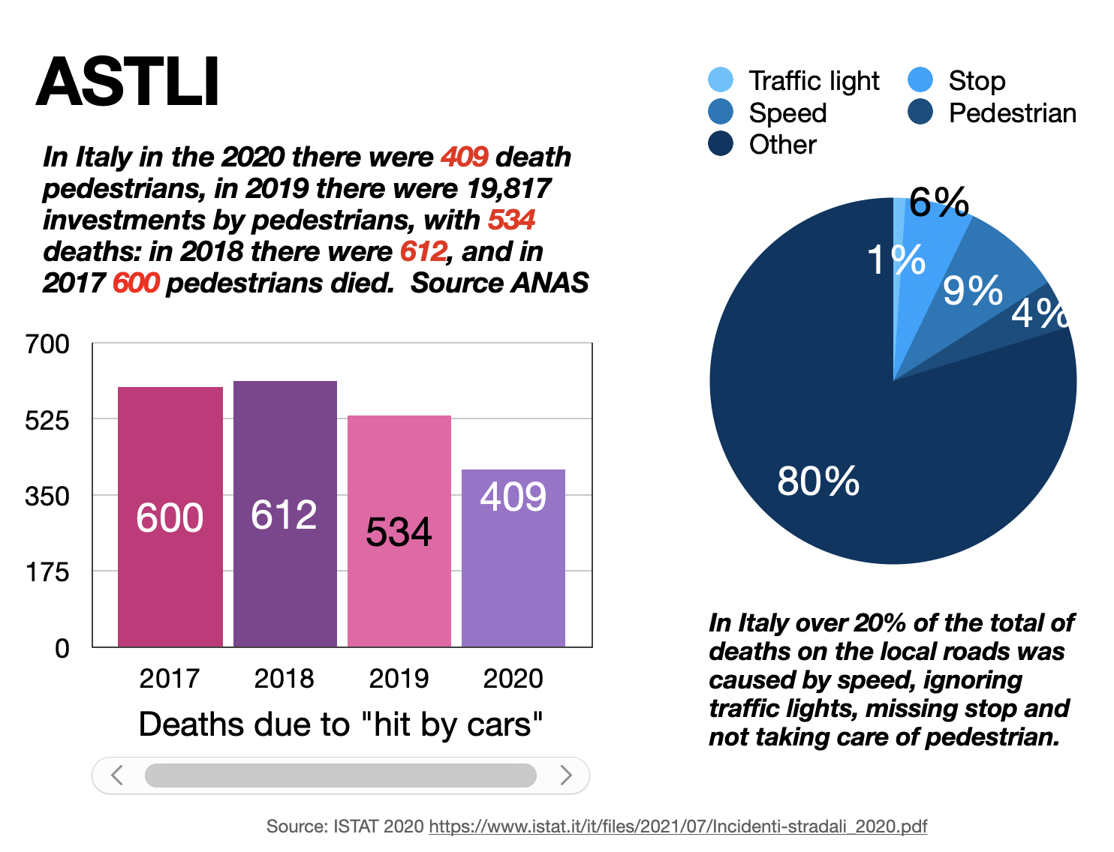

Slide 7

ASTLI
Energy: keeping traffic lights fully on when no cars are in the line is a waste of energy, even by day.

Slide 8

How ASTLI could solve these problems?

Slide 9


ASTLI
"Red light" pollution: reducing traffic lights red time analyzing current queue length and neighbors traffic lights, also by activating right/left turn depending on detected traffic.
Optimized: give more time to busiest lines
Control turn lights depending on traffic

Slide 10


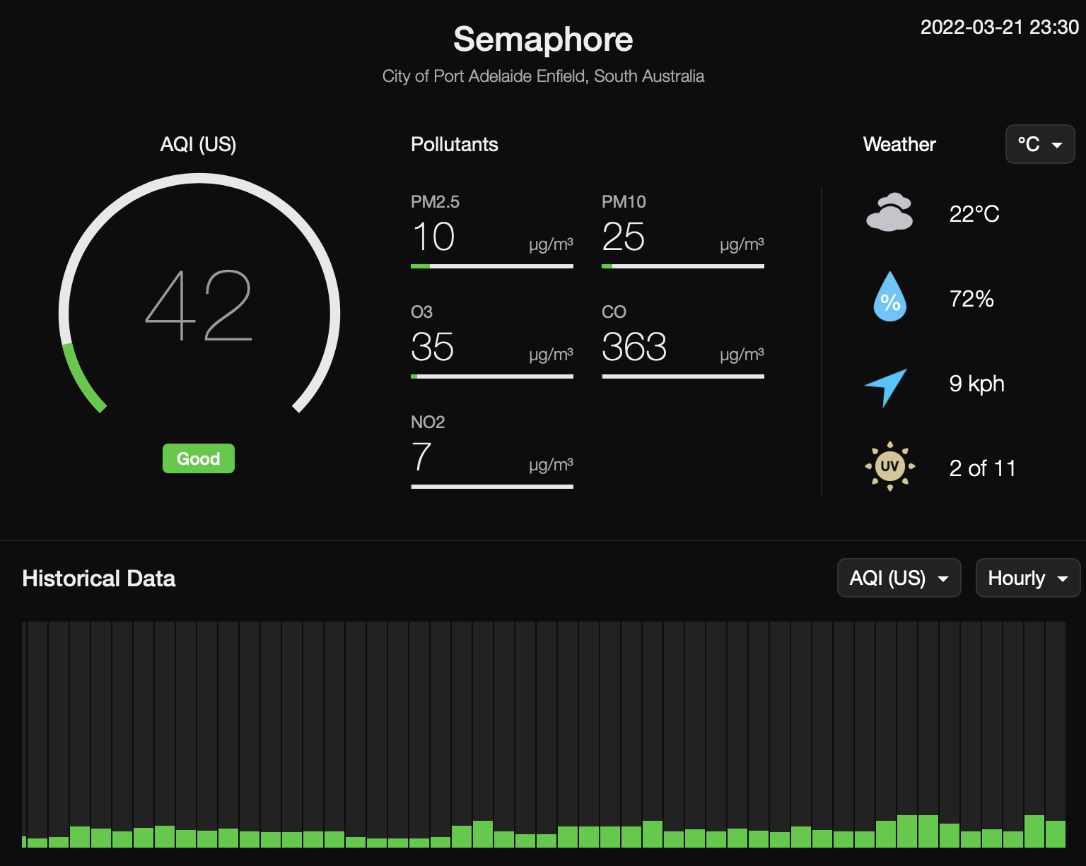
ASTLI
Air pollution: becoming pollutions stations, recording data which lets municipal administrations plan viability improvements.

Slide 11


ASTLI
Pedestrians security: enabling traffic lights during night when a pedestrian is detected (instead of yellow blinking).

Slide 12


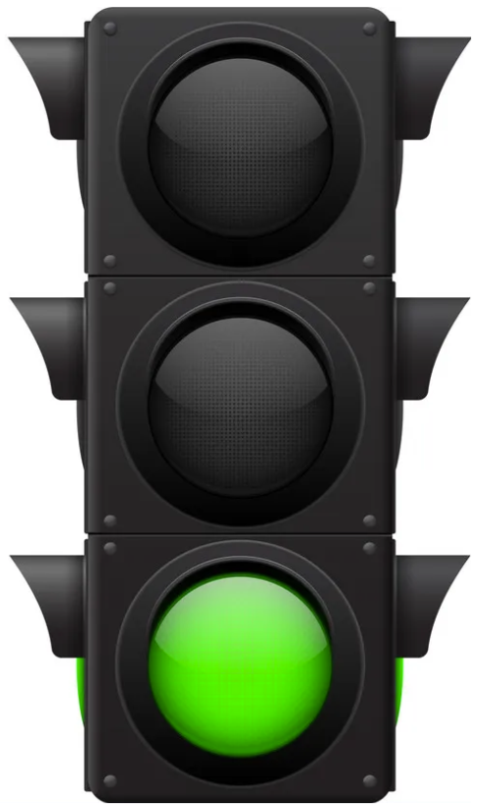
ASTLI
Drivers/pedestrian security: enabling traffic lights facing red during night when driver excessive speed is detected.

Slide 13



ASTLI
Drivers/pedestrian security: enabling traffic lights facing red during night when driver excessive speed is detected.

Slide 14

ASTLI
Energy: reducing lights signals frequency time during day and night when no cars/pedestrians are detected.

Slide 15
ASTLI
Thank you

